Slide 1
PSY 652
Lab 8

Slide 2
Announcements
Reminder: Exam moved to Nov. 3rd. Review session in lab on Oct. 27th
MIDUS project and Li replication HW assignments forthcoming
Quiz 6 corrections

Slide 3
Chronbach’s alpha
A widely used measure of reliability
Reliability: The ability of a psychometric instrument to measure constructs consistently across a variety of contexts
Provides an index of the internal consistency of a scale.
The extent to which all the items in a scale are related to one another/ measuring the same thing.
Also provides an index of the amount of measurement error in the scale
Range: [0,1]
Higher scores = more internal consistency & less measurement error.
>= 0.7 is considered good.

Slide 4
psych::alpha()
Description:
This function reports two estimates: Cronbach's coefficient alpha and Guttman's lambda_6. Also reported are item - whole correlations, alpha if an item is omitted, and item means and standard deviations.

Slide 5
Example
Full_data <- cbind(x1, x2, x3, y1, y2, y3) #Create a sample dataset
Scale_x <- Full_data %>% #Create a new object (will contain reliability info)
select(x1, x2, x3) %>% #subset data (only those items in your scale)
alpha() #apply the psych::alpha() function
Scale_x #view the new object you created

Slide 6
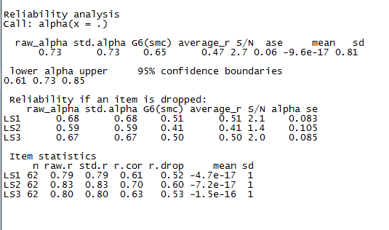

Slide 7
Output
Key output components:
Reliability analysis
Std.alpha: chronbach’s alpha (all variables as Z scores)
Item statistics:
Std.r: correlation of a single item and the total of all items
Reliability if an item is dropped:
Std.alpha: how does removing the item affect alpha? No change means the item isn’t related.

Slide 9
Creating scale variables in R
Items are often reversed to reduce monotony for the participant.
These must be reverse coded before creating the scale variable.
Individual items and scale variables may be standardized as appropriate.
Creating scale variables is usually done by taking the sum or the average of the scale items

Slide 10
Creating scale variables in R
Recoding/ reverse coding items
mutate() & ifelse()
Reverse coding Likert variables:
Original -> New
1 5
2 4
3 3
4 2
5 1

Slide 11
Creating scale variables in R
Standardizing variables (calculating z scores)
mosaic::zscore()
Creating scale variable from the sum or average of scale items
Sum() and mean() apply to columns in R, but we need the sum/mean of rows when creating scale variables!

Slide 12
Creating scale variable from the sum or average of scale items
To solve this issue, we can use the function rowwise()
rowwise() tells R to apply everything that follows it to rows instead of columns
Full_data<-full_data %>%
rowwise()%>%
mutate(x_scale_var = sum(c(x1, x2, x3)))

